Slide 1
Introduction to Machine Learning
Computer Science BSc
Compulsory Electible Course
ELTE, Faculty of Informatics

Slide 2
Logistics

Slide 3
Classes
Wednesday, 16:00-16:45 (45 mins!)
North Building, Lecture Hall, -1.75

Slide 4
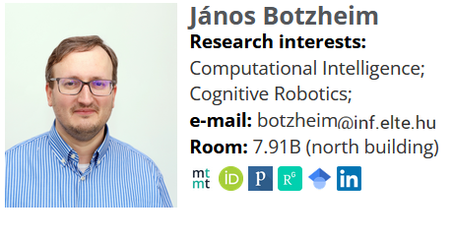
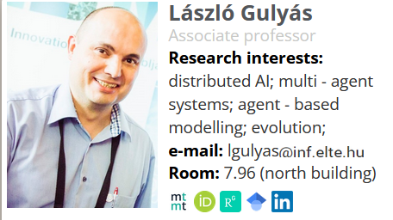
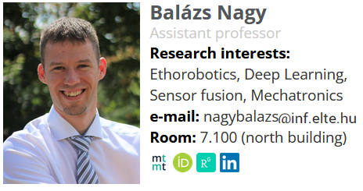
Lecturers
Email contacts:
Any of us
Only with subjects starting with [Intro2ML]

Slide 5
Requirements
Assignments
Grading
1 End-of-Semester Test
Compulsory
Written
In person
100 points
2 optional homework projects
Applying existing AI tools
Documenting it
10 points each
Points | Grade
0-39 | 1
40-54 | 2
55-69 | 3
70-84 | 4
85-120 | 5

Slide 6
Course Plan
Intro and Brief History (Gulyás)
AI as Optimisation (Gulyás)
ChatGPT & Ethics (Nagy)
Supervised Learning (Botzheim)
Unsupervised Learning (Botzheim)
Reinforcement Learning (Nagy)
Evolutionary Algorithms (Botzheim)
Bioinspired Collective Algorithms (Gulyás)
Swarm Intelligence (Botzheim)
Neural Networks (Botzheim)
Ethorobotics (Nagy)
Multi-Agent Simulations & Learning (Gulyás)
Applications (Nagy)

Slide 7
Brief History of AI
Introduction to Machine Learning Computer Science BSc Course, ELTE Faculty of Informatics
László Gulyás
Associate Professor Department of Artificial Intelligence lgulyas@inf.elte.hu

Slide 8
AI = Machine Learning?
Machine Learning originates in Artificial Intelligence
But AI has many other tools and methods
Current AI is dominated by (deep) machine learning
Machine Learning is used outside of AI proper as well
Data Science
Autonomous Systems
Etc.

Slide 9
What is AI?

Slide 10

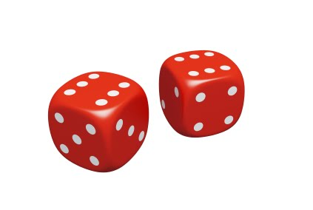
Since when?

Slide 11
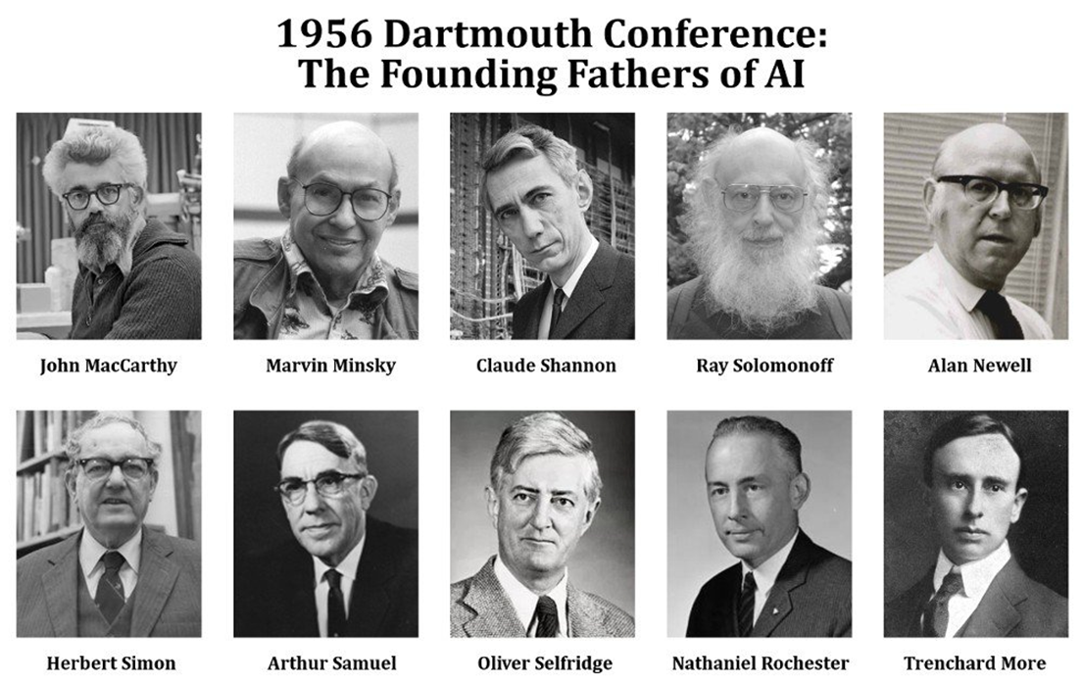
The Founding Fathers

Slide 12
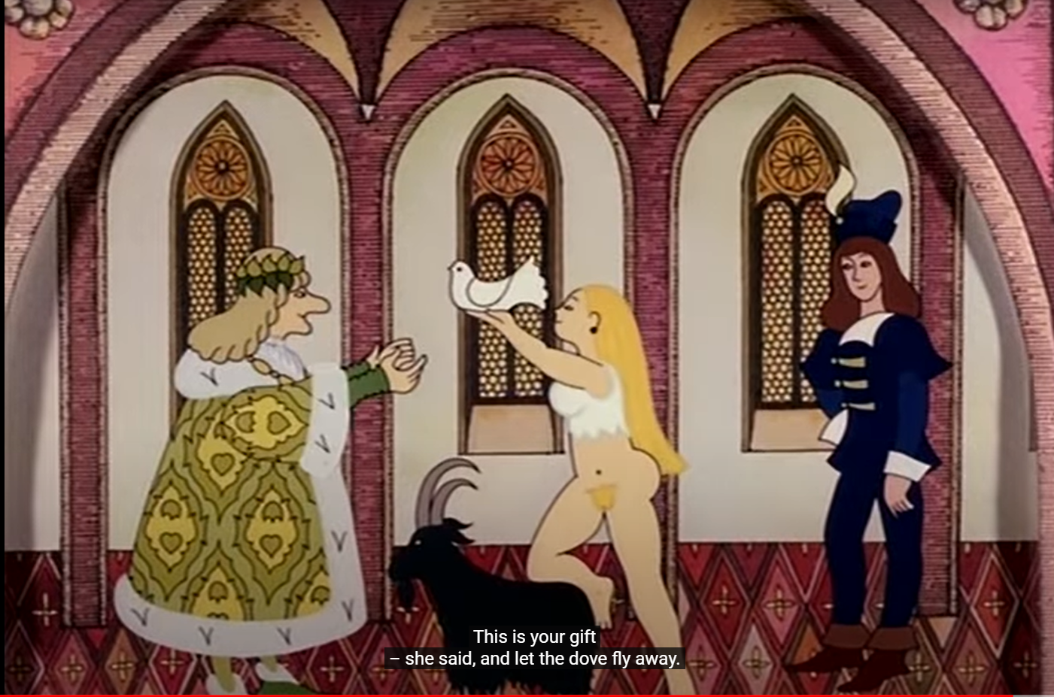
Old Research Programme Any Success before 2000?
Notes:
Hungarian Folk Tale: The Smart Daughter of the Judge
Brough it and not – the same time

Slide 13
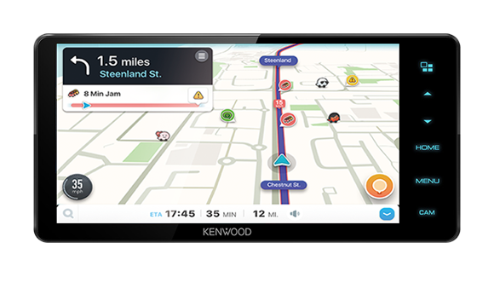
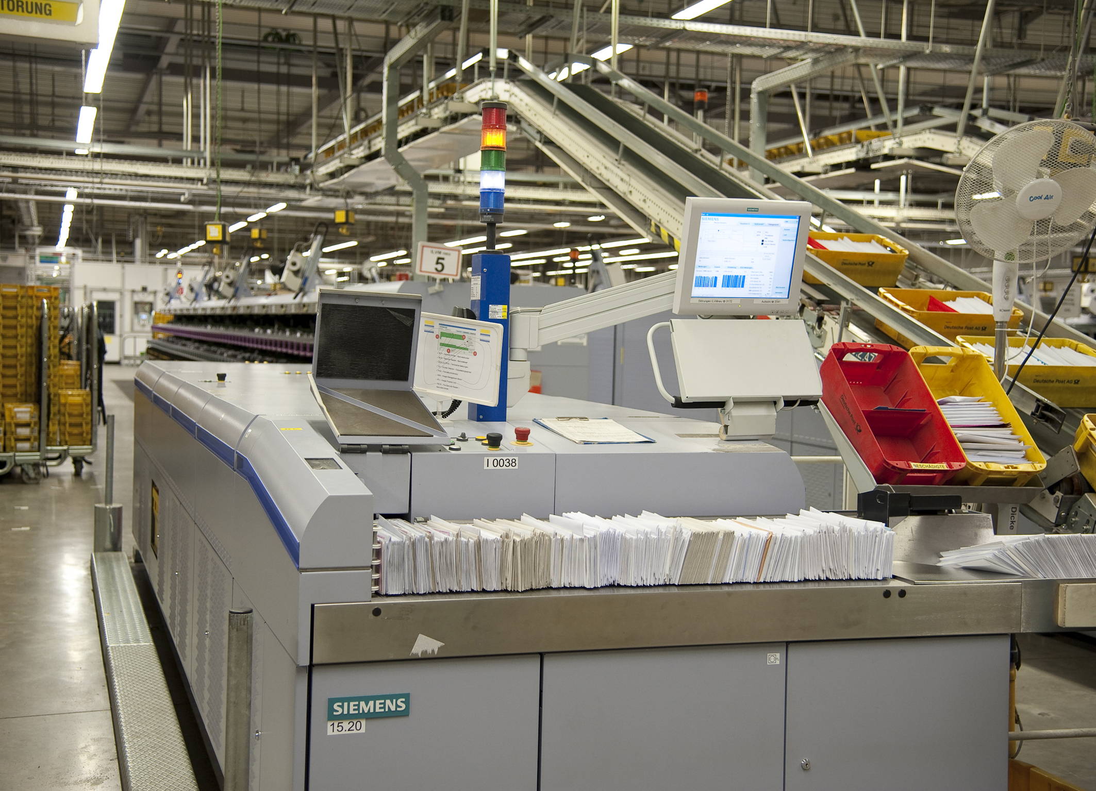
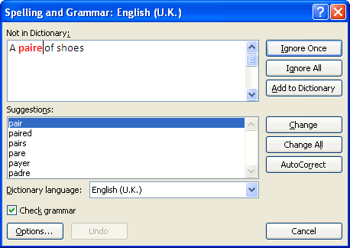
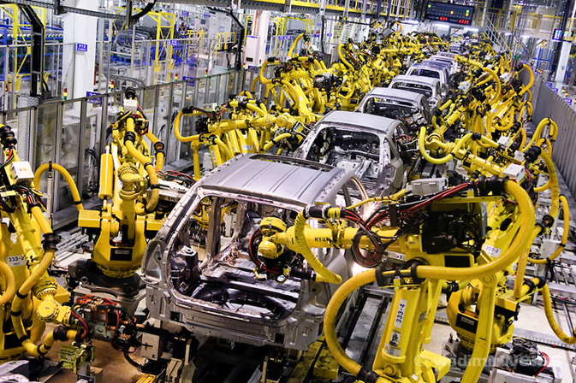
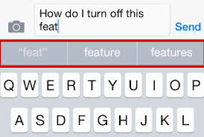
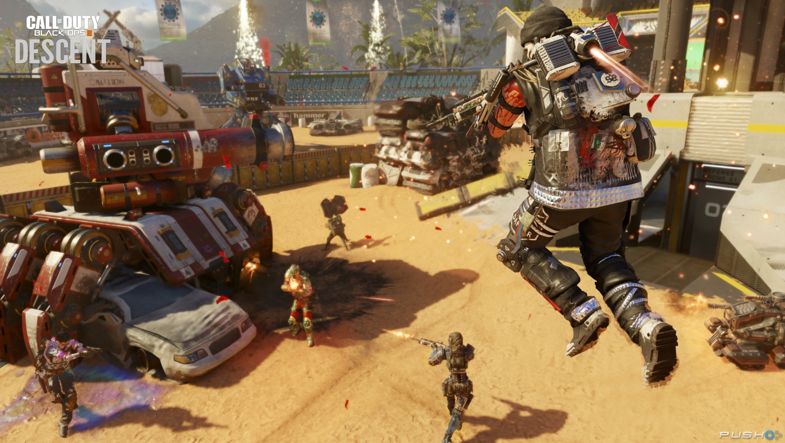
‚Old’ Results of AI

Slide 14

So, what is AI after all?

Slide 15
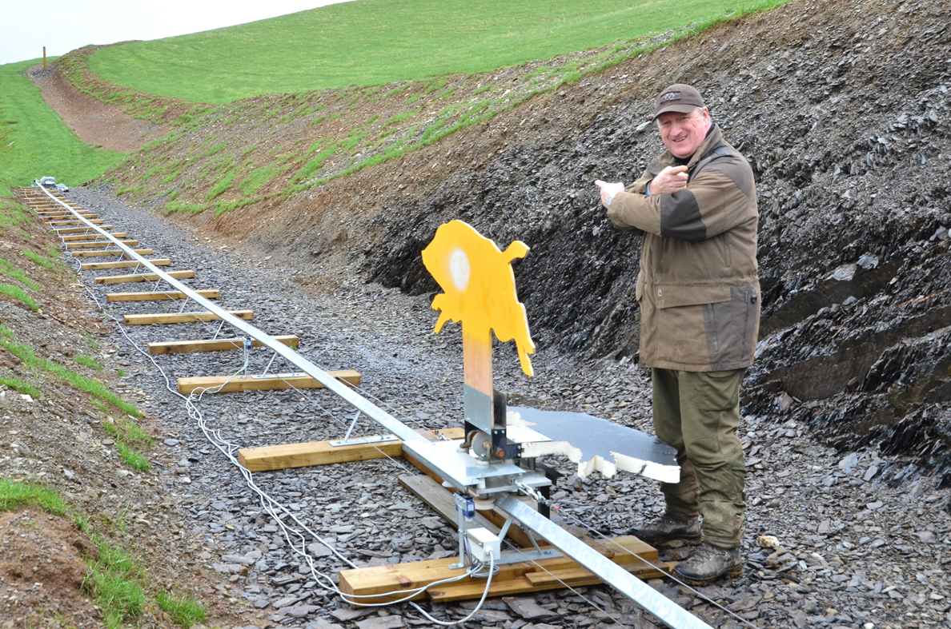
A Moving Target

Slide 16
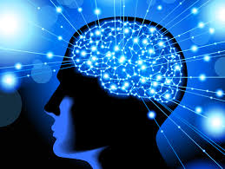
What is Intelligence, BTW?
Difficulty of defining
We only have a single example – humans
Cf. Animal cognition

Slide 17
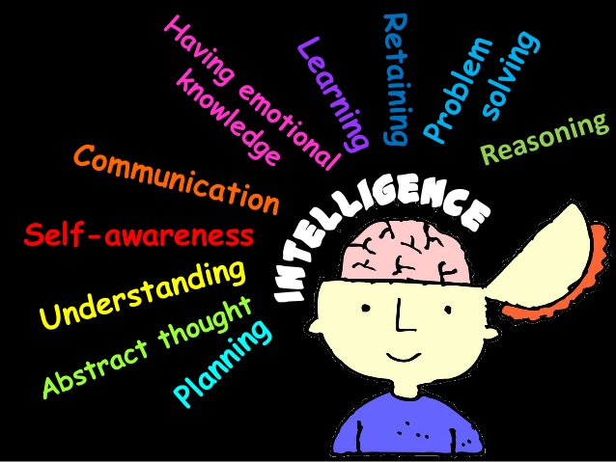
What is the goal of AI?
One could think of many possibilities:
Problem solving?
Helping humans?
Creation of a synthetic brain?
Creation of synthetic mind/cognition?
Creation of a (artificial) human?
Notes:
For creating new humans we have a method, perfected over million years. I would say, well, it’s satisfactory.

Slide 18
Digitalisation ~ Mechanisation (21th Century)
Machines + Digitalisation = „AI”

Slide 19
AI is not a miracle
It is a machine
Created by humans – to be better at something (than humans)
Better as in faster, cheaper, more precise, etc.
Cf. Sewing machine

Slide 20
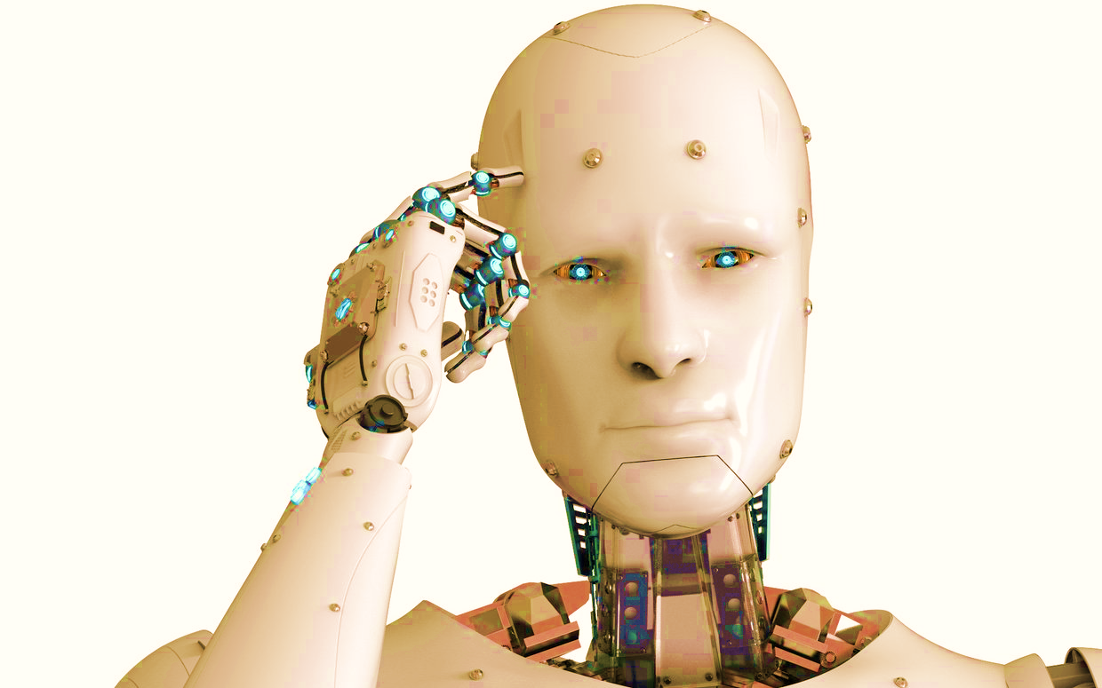
Digitalisation ~ Mechanisation (21th Century)
Machines + Digitalisation = „AI”

Slide 21
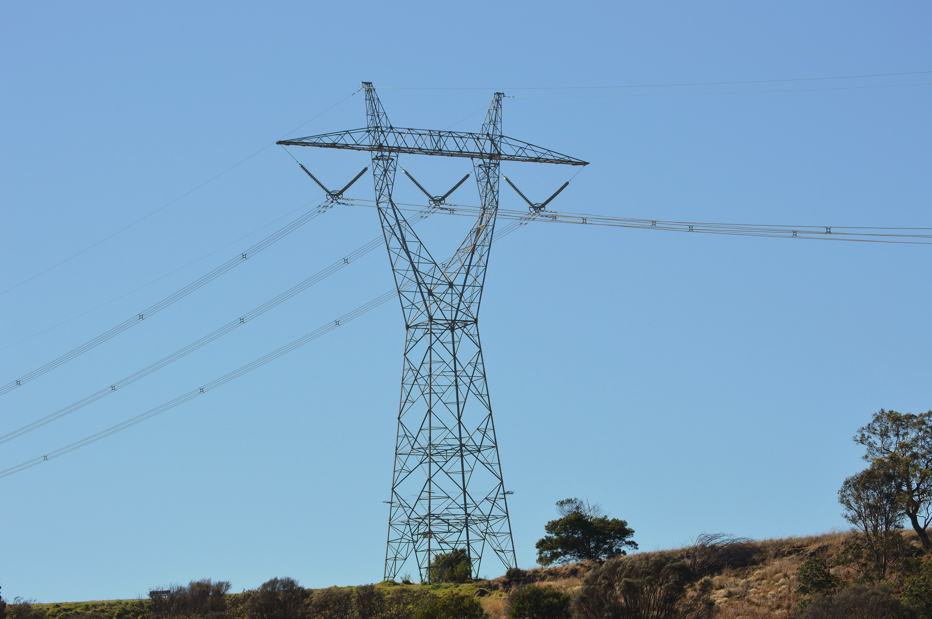
Digitalisation ~ Mechanisation (21th Century)
Machines + Digitalisation = „AI”
Notes:
We do not even notice it. Only if it does not function. Yet, we depend on it.

Slide 22
What is AI? – A Kind of Conclusion
AI is tomorrow’s computing
Today’s computing is yesterday’s AI
In our phones,
In the cloud,
In IoT networks, etc.

Slide 23

Important Distinctions
Narrow AI
Can match (or surpass) human performance
In a given (narrow) domain
At a specific task
Artificial General Intelligence (AGI)
Can (learn to) match (or surpass) human performance
In any intellectual task that humans (or animals) can perfoms

Slide 24
Important Distinctions
Narrow AI
Can match (or surpass) human performance
In a given (narrow) domain
At a specific task
Artificial General Intelligence (AGI)
Can (learn to) match (or surpass) human performance
In any intellectual task that humans (or animals) can perfoms
Other (theoretical) concepts
Syngularity
Runaway, i.e., uncontrollable technology
Superintelligence
Qualitatively surpasses human intelligence
Humans cannot even understand it
Conscious machines
What is cognition?
Theory of mind

Slide 25
Tests for AGI, Pt 1 https://en.wikipedia.org/wiki/Artificial_general_intelligence
Turing Test (Turing)
A machine and a human both converse unseen with a second human
The second human must evaluate which of the two is the machine
The test is passed if the evaluator is fooled a significant fraction of the time
Note:
Turing does not prescribe what should qualify as intelligence, only that knowing that it is a machine should disqualify it.
The AI Eugene Goostman achieved Turing's estimate of convincing 30% of judges that it was human in 2014
Robot College Student Test (Goertzel)
A machine enrolls in a university, taking and passing the same classes that humans would, and obtaining a degree
Some LLMs can now pass university degree-level exams without even attending the classes
Employment Test (Nilsson)
A machine performs an economically important job at least as well as humans in the same job
AIs are now replacing humans in many roles as varied as fast food, and marketing
Is this narrow AI?

Slide 26
Tests for AGI, Pt 2 https://en.wikipedia.org/wiki/Artificial_general_intelligence
Ikea Test (Marcus)
Also known as the Flat Pack Furniture Test
An AI views the parts and instructions of an Ikea flat-pack product, then controls a robot to assemble the furniture correctly
Coffee Test (Wozniak)
A machine enters an average home and figures out how to make coffee:
Finds the coffee machine,
Finds the coffee,
Adds water,
Finds a mug, and
Brews the coffee by pushing the proper buttons
This has not yet been completed

Slide 27
Brief History of AI

Slide 28
Waves of AI
d
Beginning
AI Winter
AI Winter
1956
1970
1980
1990
2000
2010

Slide 29
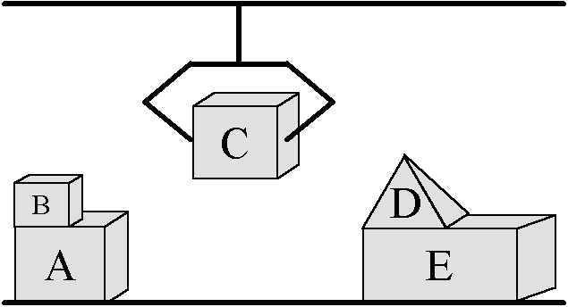
First Wave
‚Frontal Attack’
‚A little bit of everything’
Optimism
General Problem Solving
Path planning
Heuristics
Automated theorem proving (resolution)
Classic approaches to games
Minimax, Alpha-Beta cut
Seeds of Machine Learning

Slide 30
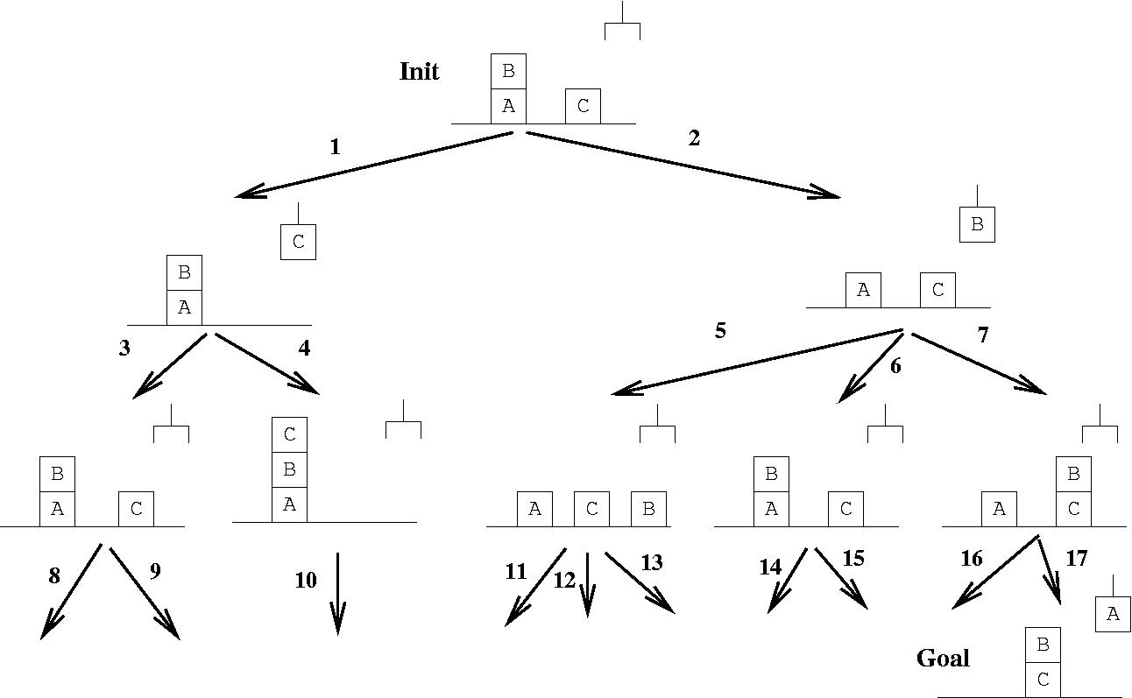
General Problem Solving

Slide 31
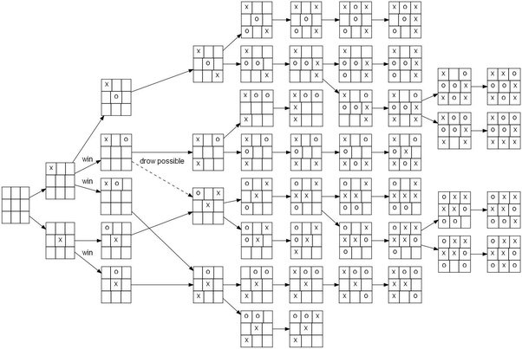
General Problem Solving -- Games

Slide 32
The Problem of Chess
Number of potential games: ~10¹²⁰

Slide 33
The Problem of Chess
Number of potential games: ~10¹²⁰
Number of atoms in the known universe (estimate): ~10⁸⁰

Slide 34
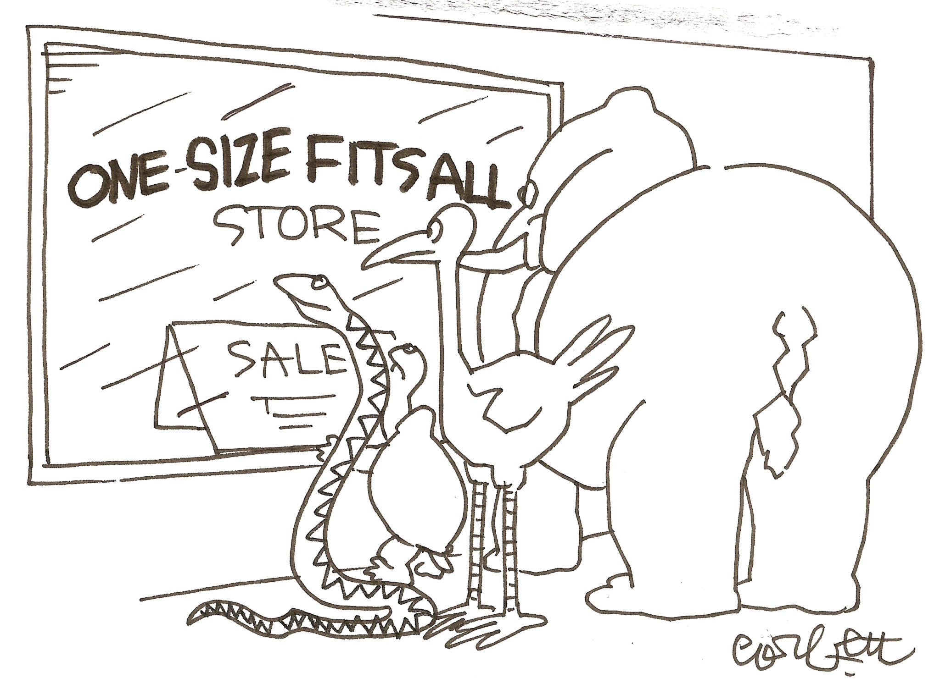
One Size Does NOT Fit All (Brute force is not enough)

Slide 35
Other Problems
World is rich
Hard to translate to the abstract language of the GPS
E.g., ‚Cube World’ is rather artificial
Yet, it is daunting to specify what is possible and what is not
GPS is rigid and slow
World is dynamic and changing fast

Slide 36
Yet, some results are still widely used today

Slide 37
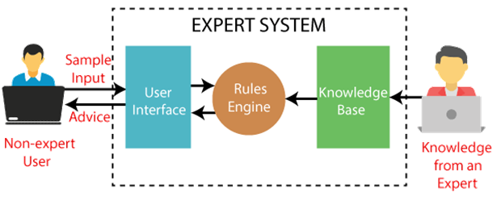
Second Wave
Expert Systems
Solve complex problems by reasoning
Through bodies of knowledge
Represented mainly as if–then rules
Rather than through procedural code
Main components
Inference Engine
Knowledge Base (≠ Database!)
Special topics
Knowledge representation
Logic programming (to describe rules)
First commercial successes of AI

Slide 38
Mini-Wave of 1990s – Autonomous, Situated Intelligence
Agents
Multi-Agent Systems
World is rich and dynamic
Make it the default assumption
Forget abstract environments
Always picture the machine in an environment (situated)
Let machines react to their environment
In addition to seeking their (autonomous) goals
You are never alone
The age of the Internet
There is always someone around
A human
Another AI agent
On the Network (LAN, WAN, etc.)
On the computer (multi-tasking operating systems)

Slide 39
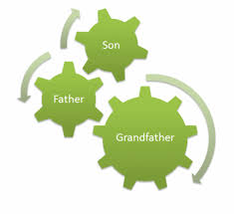
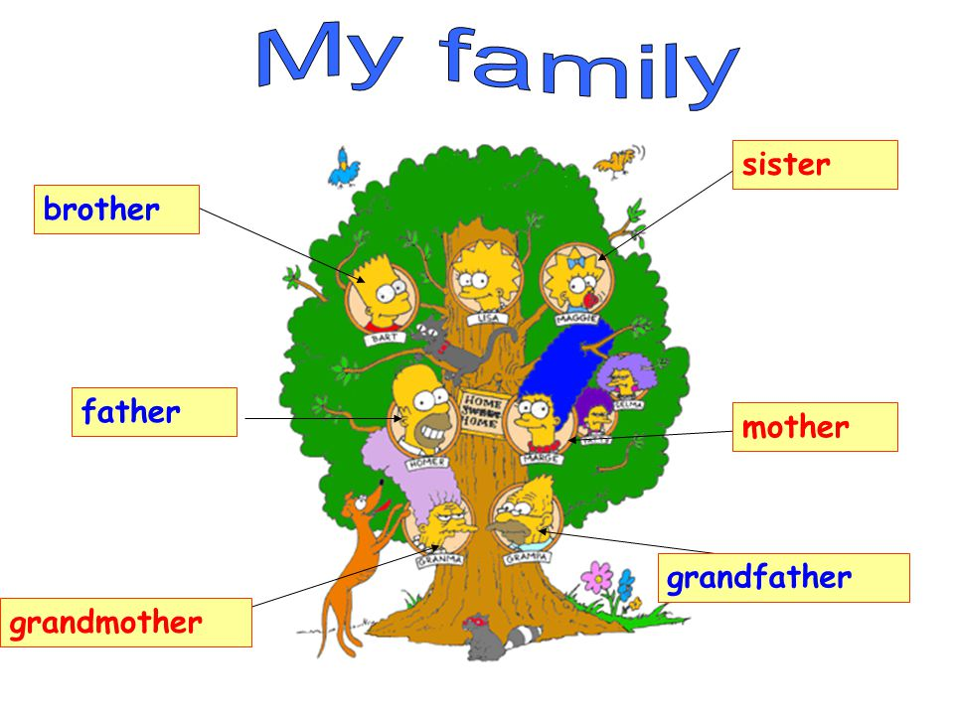

State of the Art at The Turn of Millenia
Lack of common knowledge

Slide 40
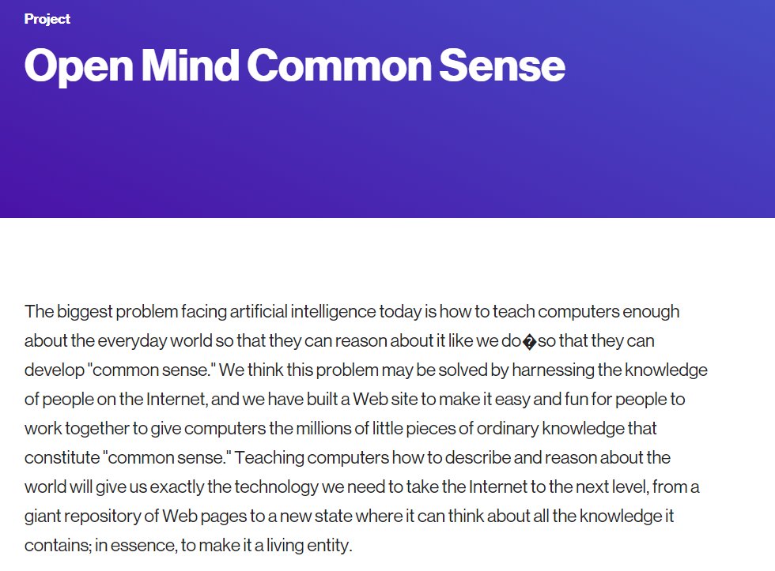

A Project by Minsky at MIT (cf. Founding Fathers)

Slide 41

It is 20+ years old now…
Is this the reason of the new AI wave?

Slide 42
It is 20+ years old now…
Is this the reason of the new AI wave?
NO

Slide 43

Internet (and smart phones)
What is the origin of Google’s name?

Slide 44
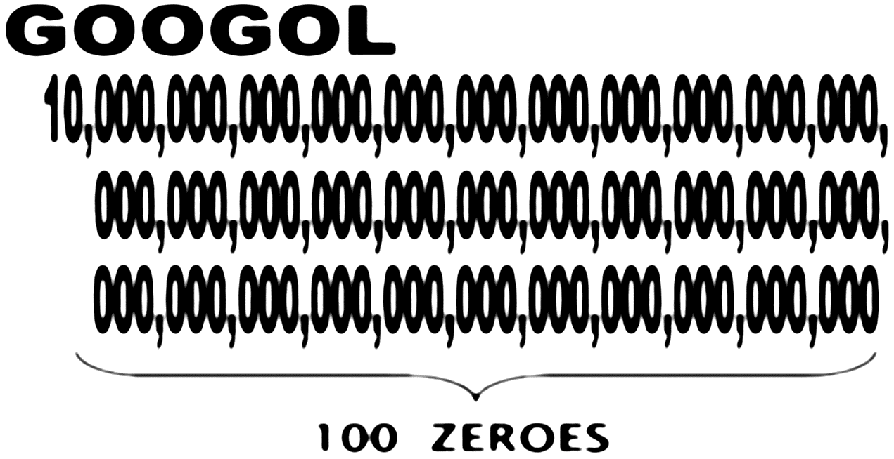
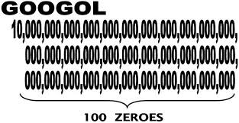
The origin of Google’s name
Notes:
Azaz sejthették előre…

Slide 45
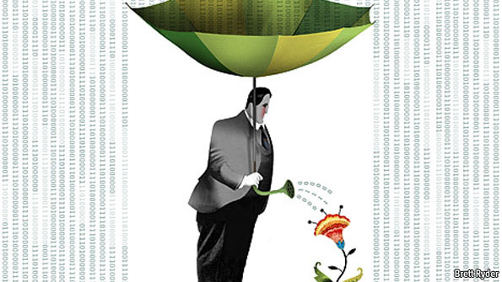
The Era of Data Economy (Big Data) Google (Apple, Facebook, Amazon, …)
Why collecting data for decades?
If you can get access to ‚all’ information at once
About the ‚whole of humanity’
Example:
Google’s speech recognition was introduced first to recognise search keywords
Trained on internet search logs since 1998

Slide 46
Additional Facilitators of the new AI wave
Advent and proliferation of GPUs
Invention of ‚deep learning’
Especially in the context of graphics → Convolutional Neural Networks

Slide 47

Fate of the Current Wave?
A significant difference:
This is the first wave to be (mostly) financed by private capital
For better or worse
Too big to fail?
Cf. Famous last words
Or colder AI winter than ever?
Or better marketing?
Recognition of achievements

Slide 48
Thank you!
László Gulyás
Associate Professor Department of Artificial Intelligence lgulyas@inf.elte.hu

